Slide 1
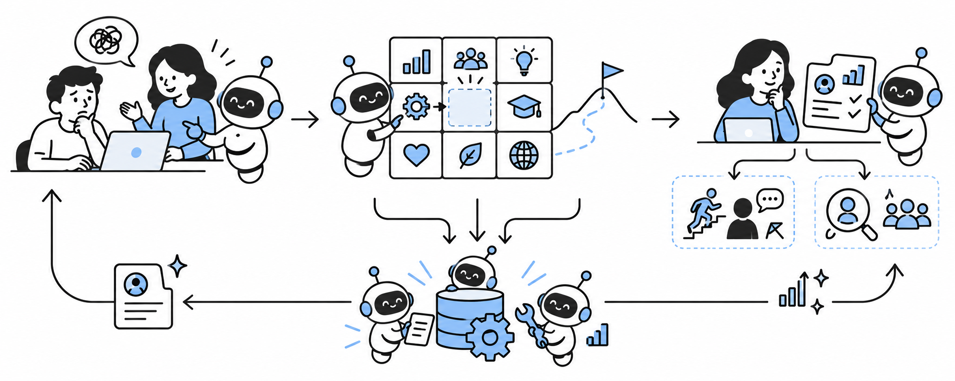
A People Ops system that keeps learning
Proposed architecture
An encounter
A capability gap
A running system
A blocked task or a conversation reveals what someone needs.
Compare work evidence with the company roadmap.
Workers update records and propose support. People decide.
Notes:
Proposed People Ops system, illustrated with hypothetical examples. These are proposed workflows, not claims of a deployed employee system or production payroll/compliance ownership. People Ops Factory (https://github.com/lpbangun/people-ops-factory) is the source prototype, using fictional data and simulated connectors. Its pattern is evidence, draft changes, human review, and next-cohort comparison. Prototype B and competing-pilot architecture here are proposed extensions. Record approved deadlines from accountable owners. Bots prepare documents and route reminders; authorized finance and specialists approve sensitive actions. Check-ins use employees' stated needs, not inferred emotions or hidden surveillance. Access to sensitive information should follow the relevant person's role. Company-specific hiring evals use job-relevant work evidence, with ownership, missing evidence and uncertainty visible. Public activity counts do not establish competence. Candidates can clarify context and provide equivalent work samples. Humans make hiring decisions. Space Grotesk font source: https://github.com/floriankarsten/space-grotesk, SIL OFL license included. Illustrations generated using the built-in image tool. Text and capability table are editable.
Slide: A People Ops system that keeps learning
An encounter A blocked task or a conversation reveals what someone needs. A capability gap Compare work evidence with the company roadmap. A running system Workers update records and propose support. People decide.

Slide 2
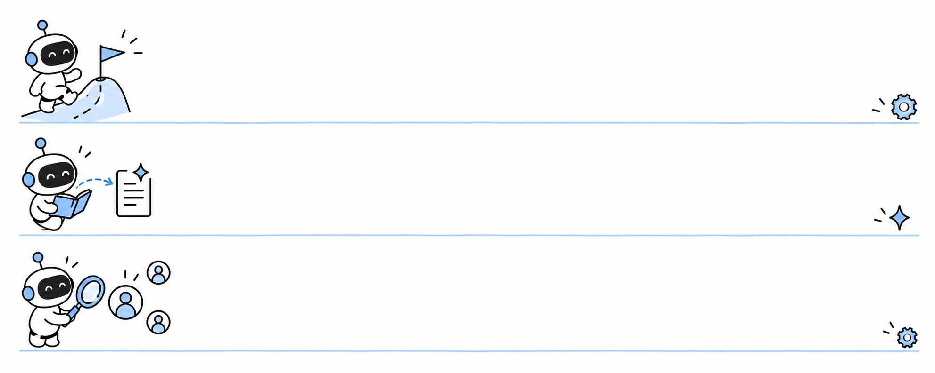
Capability gaps and the company plan
Roadmap need | Capability gap | Company decision | People Ops response
Reliable AI launch | Prototype only. Live run untested. | Pilot before launch | Arrange coached practice
Customer self-service | Guide exists. Users still need help. | Test a small cohort | Generate learning for real tasks
Expand the team | Missing expertise | Train, redeploy, or hire | Define profiles and our own evals
Market trends refresh the capability backlog. Leaders agree on roadmap changes.
Notes:
Proposed People Ops system, illustrated with hypothetical examples. These are proposed workflows, not claims of a deployed employee system or production payroll/compliance ownership. People Ops Factory (https://github.com/lpbangun/people-ops-factory) is the source prototype, using fictional data and simulated connectors. Its pattern is evidence, draft changes, human review, and next-cohort comparison. Prototype B and competing-pilot architecture here are proposed extensions. Record approved deadlines from accountable owners. Bots prepare documents and route reminders; authorized finance and specialists approve sensitive actions. Check-ins use employees' stated needs, not inferred emotions or hidden surveillance. Access to sensitive information should follow the relevant person's role. Company-specific hiring evals use job-relevant work evidence, with ownership, missing evidence and uncertainty visible. Public activity counts do not establish competence. Candidates can clarify context and provide equivalent work samples. Humans make hiring decisions. Space Grotesk font source: https://github.com/floriankarsten/space-grotesk, SIL OFL license included. Illustrations generated using the built-in image tool. Text and capability table are editable.
Slide: Capability gaps and the company plan

Slide 3
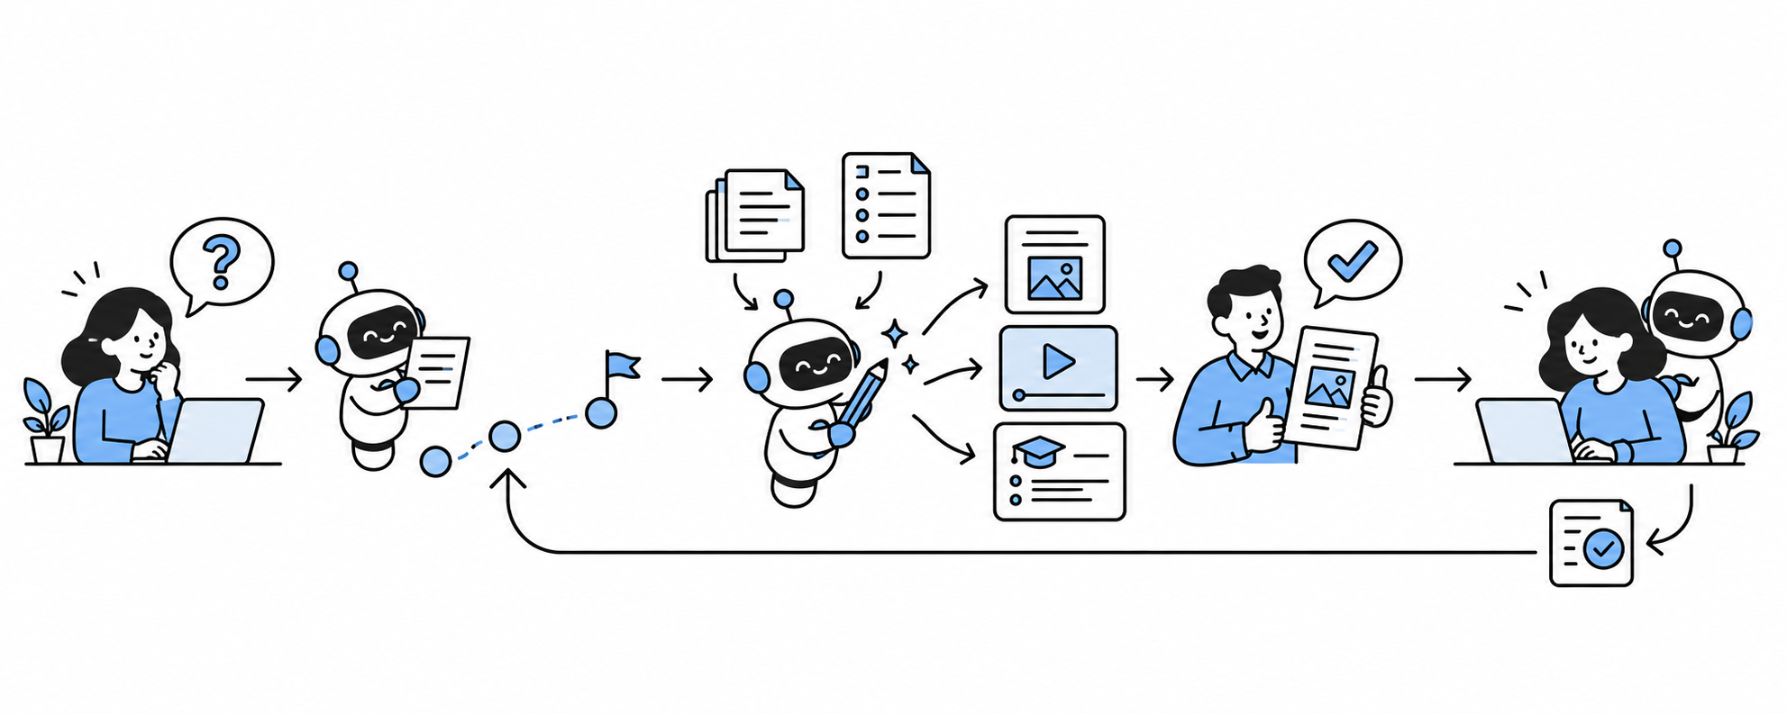
Learning content made for the work
Task + personal path
Sources become new content
Human review + practice
A personal path
Generate and review
Learn in the work
Choose the next real task and the support this person needs.
Create a short guide, video, or practice task from trusted sources.
Use it on the task. Review the outcome and update the path.
Notes:
Proposed People Ops system, illustrated with hypothetical examples. These are proposed workflows, not claims of a deployed employee system or production payroll/compliance ownership. People Ops Factory (https://github.com/lpbangun/people-ops-factory) is the source prototype, using fictional data and simulated connectors. Its pattern is evidence, draft changes, human review, and next-cohort comparison. Prototype B and competing-pilot architecture here are proposed extensions. Record approved deadlines from accountable owners. Bots prepare documents and route reminders; authorized finance and specialists approve sensitive actions. Check-ins use employees' stated needs, not inferred emotions or hidden surveillance. Access to sensitive information should follow the relevant person's role. Company-specific hiring evals use job-relevant work evidence, with ownership, missing evidence and uncertainty visible. Public activity counts do not establish competence. Candidates can clarify context and provide equivalent work samples. Humans make hiring decisions. Space Grotesk font source: https://github.com/floriankarsten/space-grotesk, SIL OFL license included. Illustrations generated using the built-in image tool. Text and capability table are editable.
Slide: Learning content made for the work
A personal path Choose the next real task and the support this person needs. Generate and review Create a short guide, video, or practice task from trusted sources. Learn in the work Use it on the task. Review the outcome and update the path.

Slide 4
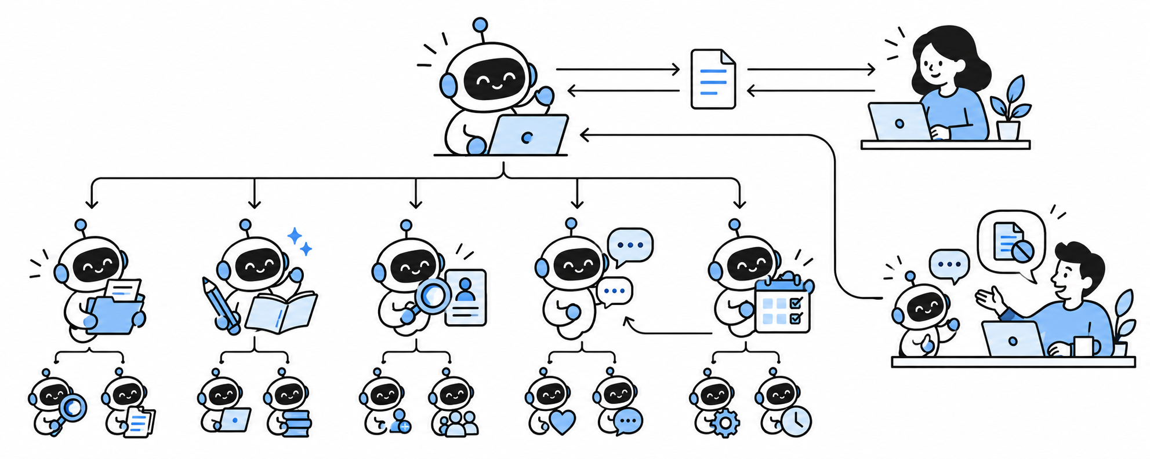
A bot team connected to people
Chief of staff
Human People Ops
Review
Learning
Recruiting
Check-in
Routines
Employee check-in
Employee explains a blocker. Helpers report to the check-in worker and chief.
The chief brings requests to People Ops. People respond and follow through.
Notes:
Proposed People Ops system, illustrated with hypothetical examples. These are proposed workflows, not claims of a deployed employee system or production payroll/compliance ownership. People Ops Factory (https://github.com/lpbangun/people-ops-factory) is the source prototype, using fictional data and simulated connectors. Its pattern is evidence, draft changes, human review, and next-cohort comparison. Prototype B and competing-pilot architecture here are proposed extensions. Record approved deadlines from accountable owners. Bots prepare documents and route reminders; authorized finance and specialists approve sensitive actions. Check-ins use employees' stated needs, not inferred emotions or hidden surveillance. Access to sensitive information should follow the relevant person's role. Company-specific hiring evals use job-relevant work evidence, with ownership, missing evidence and uncertainty visible. Public activity counts do not establish competence. Candidates can clarify context and provide equivalent work samples. Humans make hiring decisions. Space Grotesk font source: https://github.com/floriankarsten/space-grotesk, SIL OFL license included. Illustrations generated using the built-in image tool. Text and capability table are editable.
Slide: A bot team connected to people

Slide 5
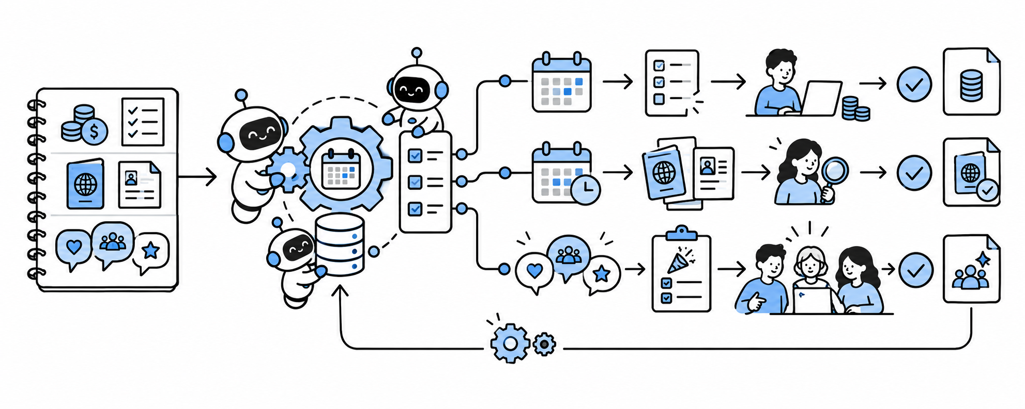
Turning People Ops routines into automation
Define the routine
Build the shared engine
Run the workflow with approvals
Payroll
Immigration + policy
Team events
Cutoff triggers input checks. Finance reviews and approves.
Due dates trigger document prep. Specialists review exceptions.
Gather preferences, draft a plan, then let people choose together.
Notes:
Proposed People Ops system, illustrated with hypothetical examples. These are proposed workflows, not claims of a deployed employee system or production payroll/compliance ownership. People Ops Factory (https://github.com/lpbangun/people-ops-factory) is the source prototype, using fictional data and simulated connectors. Its pattern is evidence, draft changes, human review, and next-cohort comparison. Prototype B and competing-pilot architecture here are proposed extensions. Record approved deadlines from accountable owners. Bots prepare documents and route reminders; authorized finance and specialists approve sensitive actions. Check-ins use employees' stated needs, not inferred emotions or hidden surveillance. Access to sensitive information should follow the relevant person's role. Company-specific hiring evals use job-relevant work evidence, with ownership, missing evidence and uncertainty visible. Public activity counts do not establish competence. Candidates can clarify context and provide equivalent work samples. Humans make hiring decisions. Space Grotesk font source: https://github.com/floriankarsten/space-grotesk, SIL OFL license included. Illustrations generated using the built-in image tool. Text and capability table are editable.
Slide: Turning People Ops routines into automation
Payroll Cutoff triggers input checks. Finance reviews and approves. Immigration + policy Due dates trigger document prep. Specialists review exceptions. Team events Gather preferences, draft a plan, then let people choose together.

Slide 6
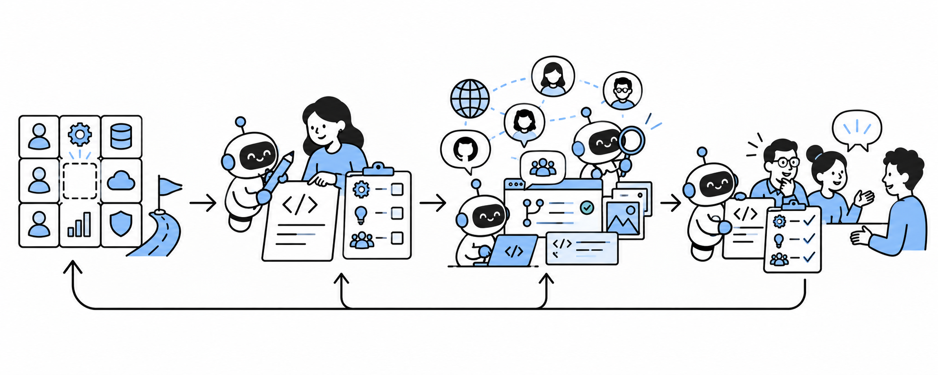
Recruitment built around our own evals
Gap + profile
Task + rubric
Find relevant work
Review evidence
Company gap
Company evals
Sourcing channels
Evidence review
Roadmap gap defines the role
and profiles to reach.
Our own task and rubric.
Quality and ownership.
Collaboration in the work.
GitHub, X, portfolios.
Referrals + communities.
Relevant contributions.
Evidence against rubric.
Candidate adds context.
People decide.
Notes:
Proposed People Ops system, illustrated with hypothetical examples. These are proposed workflows, not claims of a deployed employee system or production payroll/compliance ownership. People Ops Factory (https://github.com/lpbangun/people-ops-factory) is the source prototype, using fictional data and simulated connectors. Its pattern is evidence, draft changes, human review, and next-cohort comparison. Prototype B and competing-pilot architecture here are proposed extensions. Record approved deadlines from accountable owners. Bots prepare documents and route reminders; authorized finance and specialists approve sensitive actions. Check-ins use employees' stated needs, not inferred emotions or hidden surveillance. Access to sensitive information should follow the relevant person's role. Company-specific hiring evals use job-relevant work evidence, with ownership, missing evidence and uncertainty visible. Public activity counts do not establish competence. Candidates can clarify context and provide equivalent work samples. Humans make hiring decisions. Space Grotesk font source: https://github.com/floriankarsten/space-grotesk, SIL OFL license included. Illustrations generated using the built-in image tool. Text and capability table are editable.
Slide: Recruitment built around our own evals
Company gap Roadmap gap defines the role
and profiles to reach. Company evals Our own task and rubric.
Quality and ownership.
Collaboration in the work. Sourcing channels GitHub, X, portfolios.
Referrals + communities.
Relevant contributions. Evidence review Evidence against rubric.
Candidate adds context.
People decide.

Slide 7
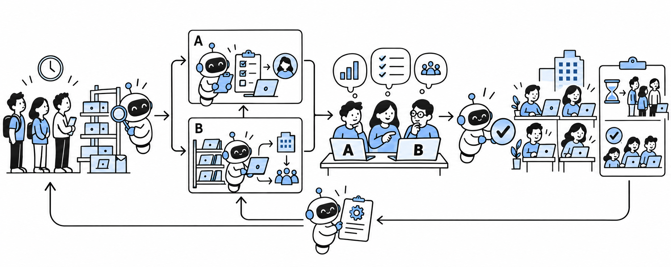
Two proofs of concept, then a company pilot
Build A and B
Compare and choose
One loop to reuse
A: early checks + backup owner.
B: spare-device pool.
Prototype in separate branches.
Compare A and B with people.
Choose a small internal pilot.
Pilot inside the company.
Measure readiness and delays.
Improve the chosen workflow.
Notes:
Proposed People Ops system, illustrated with hypothetical examples. These are proposed workflows, not claims of a deployed employee system or production payroll/compliance ownership. People Ops Factory (https://github.com/lpbangun/people-ops-factory) is the source prototype, using fictional data and simulated connectors. Its pattern is evidence, draft changes, human review, and next-cohort comparison. Prototype B and competing-pilot architecture here are proposed extensions. Record approved deadlines from accountable owners. Bots prepare documents and route reminders; authorized finance and specialists approve sensitive actions. Check-ins use employees' stated needs, not inferred emotions or hidden surveillance. Access to sensitive information should follow the relevant person's role. Company-specific hiring evals use job-relevant work evidence, with ownership, missing evidence and uncertainty visible. Public activity counts do not establish competence. Candidates can clarify context and provide equivalent work samples. Humans make hiring decisions. Space Grotesk font source: https://github.com/floriankarsten/space-grotesk, SIL OFL license included. Illustrations generated using the built-in image tool. Text and capability table are editable.
Slide: Two proofs of concept, then a company pilot
Build A and B A: early checks + backup owner.
B: spare-device pool.
Prototype in separate branches. Compare and choose Compare A and B with people.
Choose a small internal pilot. One loop to reuse Pilot inside the company.
Measure readiness and delays.
Improve the chosen workflow.

